Slide 1
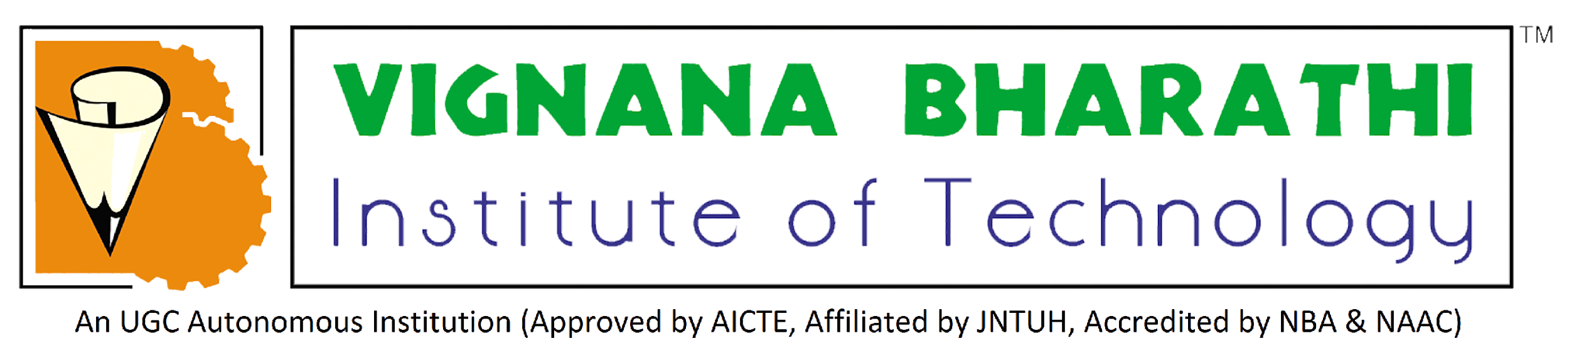
AVISHKAR
SAI KUMAR
21P61A6286
CSC - D
VARSHITH
21P61A66M4
CSM - D

Slide 2
Smart Waste Management System for Smart City

Slide 3
Problem Explanation
In today's world, we frequently see garbage bins or dust bins placed in public places are overflowing.
It creates an unhygienic condition for the people and a bad smell around the surroundings. This leads to the spread of some deadly diseases and human illnesses.
The inefficiency of the trash collection system is due to the lack of timely notification to the authorities, resulting in overflowing garbage.
To improve the quality of life for individuals, it is imperative to ensure a safer and healthier environment by enhancing the efficiency of waste collection.
To avoid such situations, we are planning to design an IoT-based solution that can greatly optimize collection services and reduce the operational cost for cities.
The shift to innovative waste management techniques involves a data-centric approach to the collection process.

Slide 4
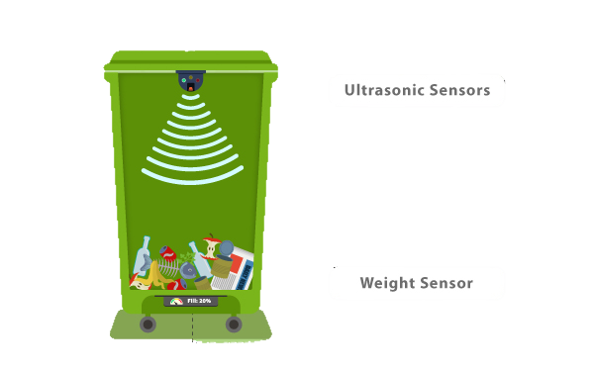
Solution
One of the solutions to the given problem is E-bins on an IoT-based platform.
The E-bins will be equipped with GPS for precise location, which will make it easier to collect and throw away the garbage.
Solar panels are affixed to the tops of the E-bins, helping to power the sensors.
Smart sensors assist in indicating the level of trash in the E-bins; once the level reaches maximum, a sign indicating "The Bag is Full" appears.
When the E-bin is full, the trash van will receive the location of the E-bin for collection of the trash.

Slide 5
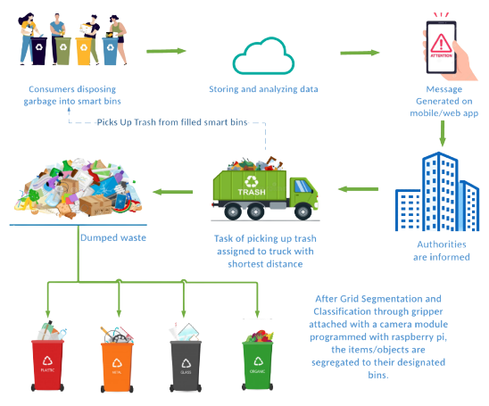
Feasibility of Solution
Waste management E-bins include smart sensors and GPS, which help to locate the trash, and E-bin fill levels are measured using ultrasound technology.
These E-bins transmit data to a smart waste management system via a cloud-based platform and several IoT protocols, allowing us to collect data.
Weight sensors help calculate the accurate weight of the trash. Solar panels are installed on top of the E-bins to help charge the battery that powers the E-bins.
Examples of such software are Sig Fox and LoRa WAN.

Slide 6
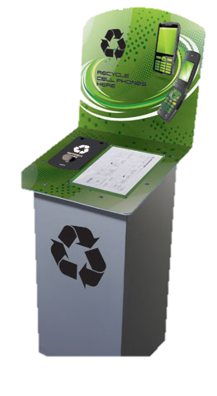
Comparing with Existing Solutions
Bins that are present today are not being maintained properly, and the trash is not being placed in a proper way.
The E-trash bins will bring new innovations and ideas to garbage collection and waste management.
When compared with other software like Zigbee, RSM, and RFID, the IoT is easier to use.
The waste management solution for E-trash bins includes smart sensors and GPS, which help in accurately locating the trash bin, and ultrasound technology is used to measure the fill level in e-trash bins.
In contrast to the other bins that rely on less accurate IR sensors and WiFi-based navigation, these
E-trash bins use a more precise system.

Slide 7
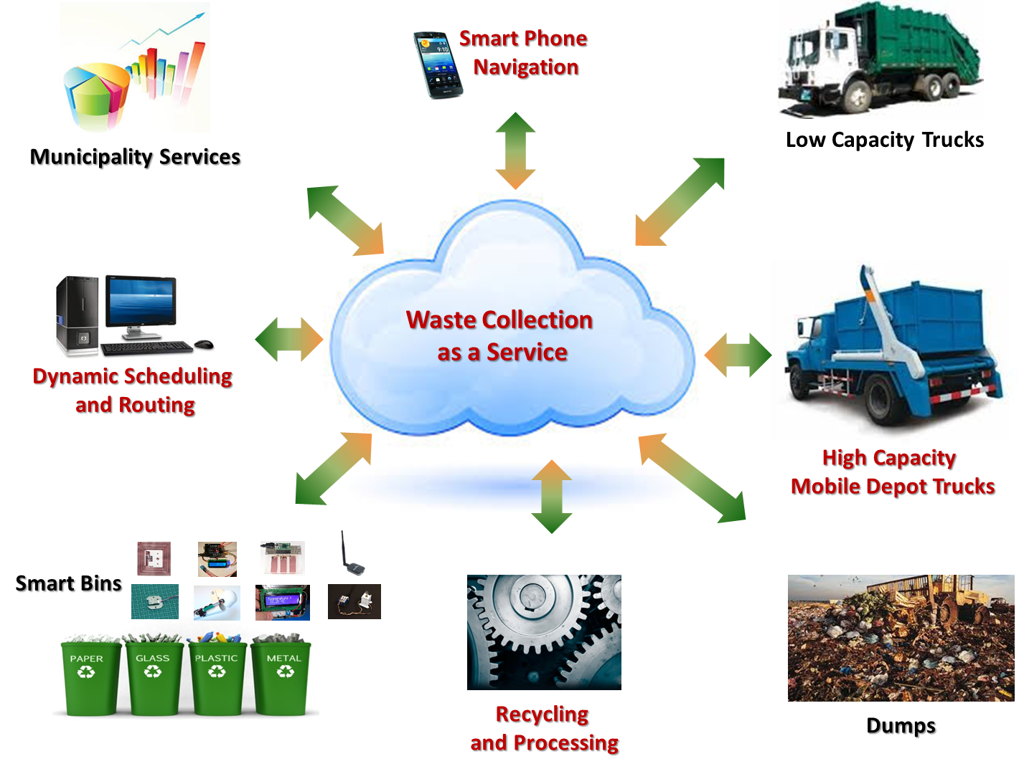
Applications
IoT applications in smart waste management systems are replacing garbage collection trucks and sanitation department workers.
These types of applications help to decrease environmental degradation and provide more efficient waste management to citizens.
It will be difficult for IoT applications to reach remote areas for smart waste management.
This system requires more waste bins for separate waste collection as per the population of the city, which results in a high initial cost due to the expensive smart dustbins compared to other methods.

Slide 8
QUERIES?

Slide 9
THANK YOU

